Slide 1
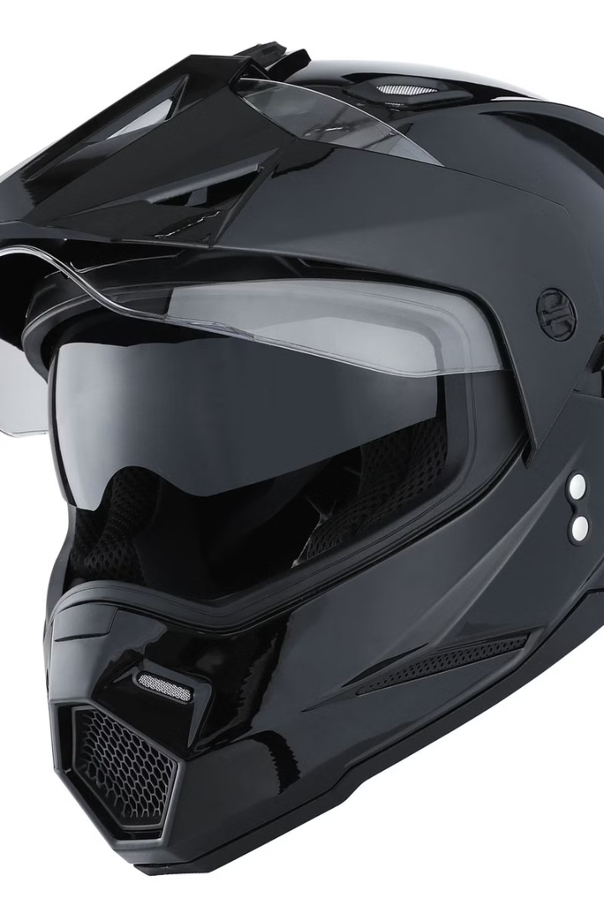
Helmet with Collision Detection and Alert System
This presentation explores a revolutionary safety technology designed to improve accident response for two-wheeler riders. We'll dive into the innovative features of a helmet equipped with a collision detection and alert system, highlighting its potential to save lives.

Slide 2
Collision Detection & Alert System
Vibration Sensor
Microcontroller
GSM Module
A vibration sensor embedded within the helmet detects impact forces during a collision. This crucial component is the heart of the system, triggering the alert mechanism.
An 8051 microcontroller processes the signal from the vibration sensor. It analyzes the data, determines the severity of the impact, and activates the appropriate alerts.
The system leverages a GSM module for communication. Upon collision detection, the microcontroller sends SMS and call alerts to pre-programmed emergency contacts.

Slide 3
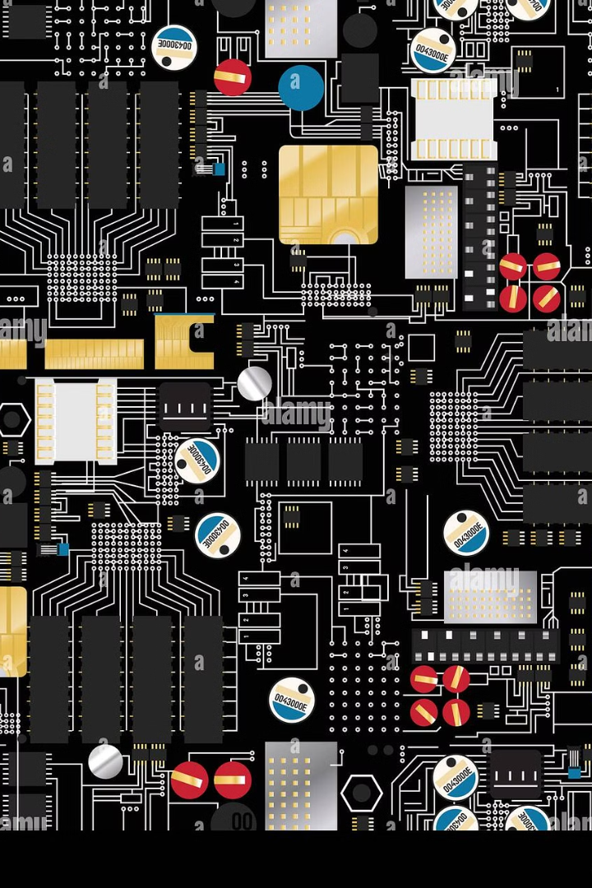
System Architecture
The vibration sensor (P3.2) is integrated into the helmet, effectively acting as the impact detector.
The 8051 microcontroller processes the sensor data and controls the alert mechanisms.
The LCD display provides real-time information, showcasing the system's status and collision detection.
A buzzer and LED indicator provide an immediate audio and visual alert, further enhancing the safety response.

Slide 4

Working Principle
1
When the helmet is in normal use, the LCD displays “Vibration: NO.”
2
Upon a collision, the vibration sensor triggers the microcontroller, causing the LCD to display “Vibration: YES.”
3
The microcontroller simultaneously activates the buzzer and the GSM module, sending emergency alerts via SMS and calls to pre-defined contacts.

Slide 5
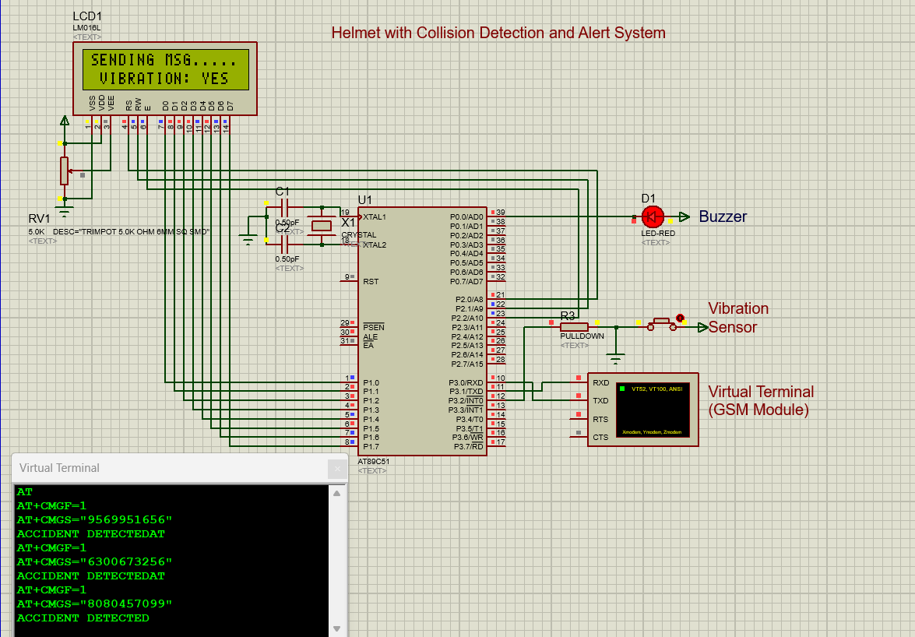
Circuit Simulation on Proteus

Slide 6

Code In KEIL Software

Slide 7




Benefits of Helmet-Based Accident Detection
This system offers a unique advantage by providing real-time collision detection directly integrated into the helmet. This ensures immediate response and reduces delays in critical situations.
Unlike traditional accident reporting methods, the automated alert system eliminates reliance on manual reporting, which can be unreliable and time-consuming in an emergency.
The dual alert system (SMS and call) increases the likelihood of reaching emergency contacts, guaranteeing rapid communication and facilitating swift rescue efforts.

Slide 8

Future Enhancements
Integrating GPS functionality will provide precise location tracking, enabling emergency responders to locate the accident site efficiently.
AI-based impact severity analysis can be implemented to assess the severity of the collision and prioritize the urgency of the emergency response.
IoT-based cloud connectivity can enable real-time data sharing, providing valuable insights for accident analysis and safety improvements.
Additional safety features like alcohol detection and fall detection can be incorporated, creating a comprehensive smart safety system for two-wheeler riders.

Slide 9



Transforming Safety for Two-Wheeler Riders
Cost-effective
1
The system offers a cost-effective solution for improving road safety, making it accessible to a wider range of riders.
Efficient
2
The automated response mechanism optimizes accident response time, ensuring faster and more efficient assistance.
Life-saving
3
The system's ability to provide immediate alerts and accurate location information can significantly increase survival chances in accidents.

Slide 10

The Future of Smart Safety Devices
10
3
2
Million
Thousand
Million
motorcycles on the road globally
accidents per day
deaths annually
With its potential to save lives and enhance rider safety, this innovative helmet technology is poised to become a standard safety feature in the future. This technology holds immense potential to reduce the number of accidents and fatalities among two-wheeler riders worldwide.

Slide 11
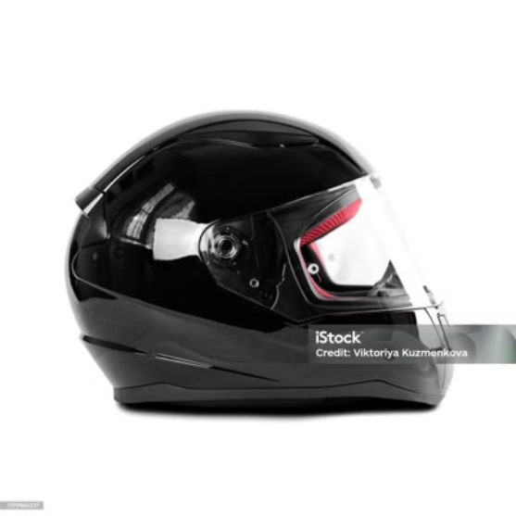
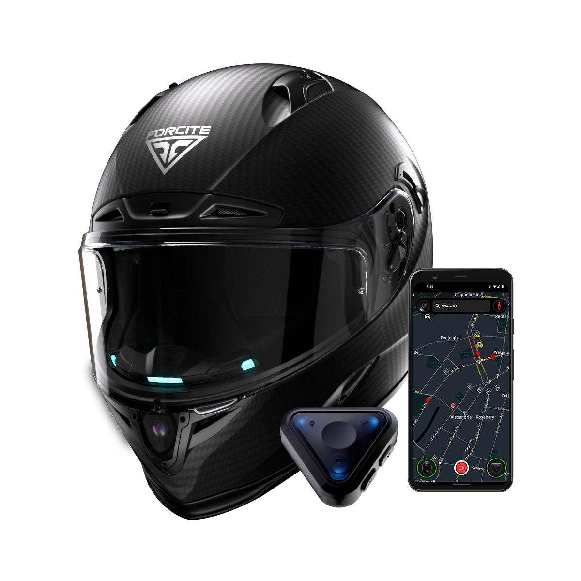
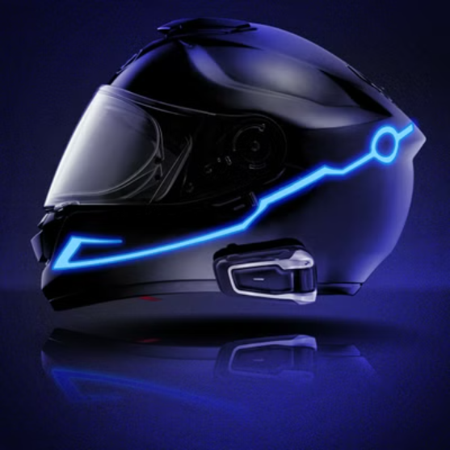
Project Summary
This project proposes a helmet-based collision detection and alert system designed to improve accident response for two-wheeler riders. The system combines a vibration sensor, microcontroller, LCD display, and GSM module for real-time accident detection and emergency alerts.
Its features include helmet-based collision detection, automated alert mechanisms, dual alert system (SMS and call), and future enhancements such as GPS, AI, and IoT integration. This cost-effective, efficient, and life-saving solution holds immense potential to transform road safety for two-wheeler riders worldwide.

Slide 12

Thank You
Thank you for your time and consideration. This project represents a significant step forward in the development of smart safety devices. We believe this technology can significantly improve the safety of two-wheeler riders globally and contribute to a safer and more secure future for all.

